Slide 1

AUTONOMOUS IRRIGATION SYSTEM USING ARDUINO

Slide 2
PROBLEM STATEMENT…
Ramu is a farmer. We all know how noble the job of farming is, but unfortunately in the last farming season, Ramu lost all of his crops due to lack of proper irrigation.
This time Ramu is quite determined to save his crops, so he has come to you for help (as you are the top roboteer). He wants you to build a bot that will help him to water his crops. This bot will water the crops when the moisture level falls below a certain minimum value.

Slide 3
BASIC IDEA…
The soil moisture sensor is placed inside the soil, near the roots of the plant.
It checks the water content of the soil and sends appropriate input signals to the Arduino Uno.
If the input signal value is higher than the required value then we consider the soil as dry else it is wet.
The relay is directed accordingly which in turn instructs the water pump.
This idea can be implemented as a part of the drip irrigation system.

Slide 4
COMPONENTS…
ARDUINO UNO
SOIL MOISTURE SENSOR FC-28
SUBMERSIBLE WATER PUMP
5V RELAY SWITCH
JUMPER WIRES

Slide 5
ALGORITHM…
Assign analog pin to the moisture sensor
Define and initialize a local variable to zero and specify the output pin
Start the loop
Read the senor value and store it in the local variable.
If the input value is more than the minimum soil sensor value content we send a “HIGH” signal to the relay which starts the water supply.
If the value is less than the minimum soil sensor value we send a “LOW” signal to cut the relay and stop the water supply.
Delay functions can be incorporated between the loops if necessary.

Slide 6
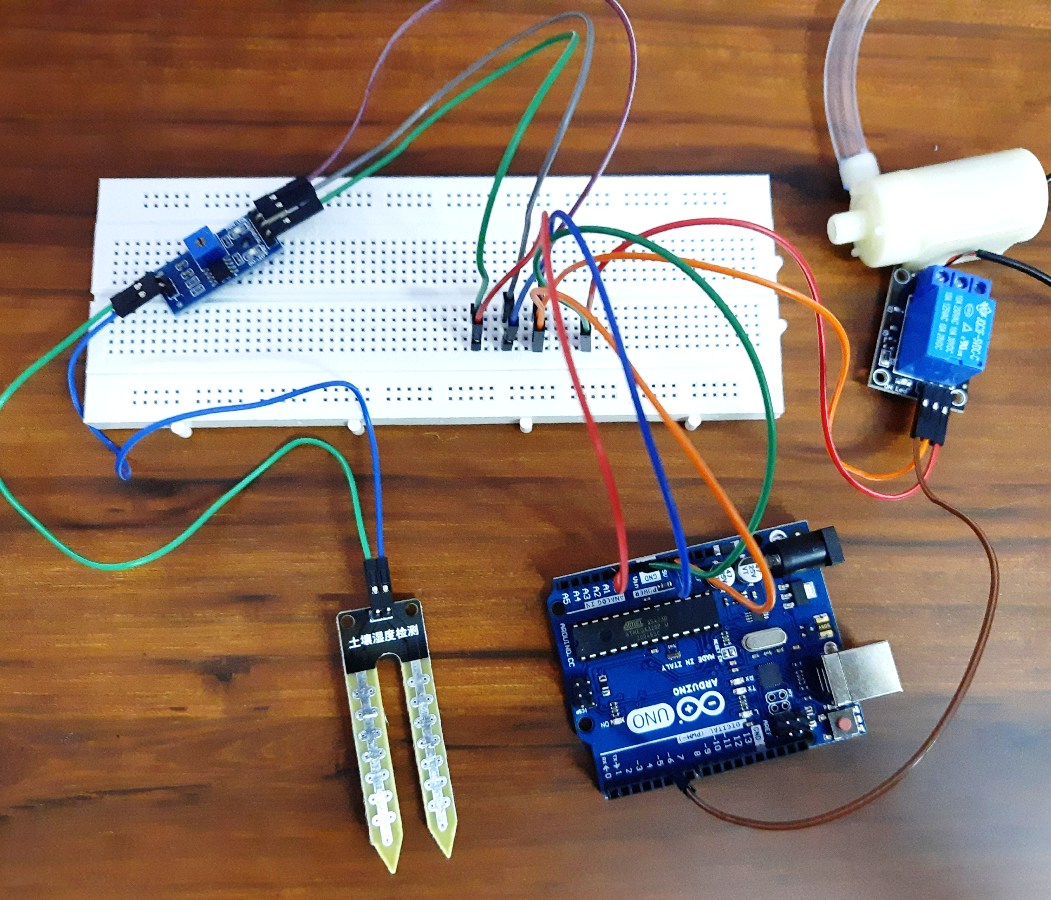
PROJECT:

Slide 7
THANK YOU

